Slide 1
Chrome Extension for MOOC forum intervention Implementation
By Ng Kheng Yi

Slide 2
Contents
Key Components
Chrome Extension
AWS Lambda

Slide 3

Chrome Extension

Slide 4
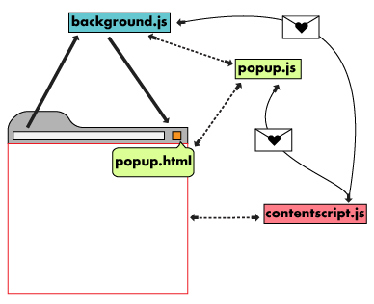
General Architecture
Consists of multiple components:
Manifest
Background Script
UI Elements
Content Script
Options Page

Slide 5
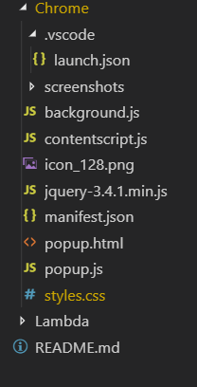
My Design
Extension does not rely on user input/interaction (Outside of clearing cache)
Content scripts only injected onto certain webpages (MOOC Forum/Thread page)
Bulk of code implemented in contentScript.js
Main Functions:
Extracting information (Page Scraping)
Communication with Lambda Function
Modifying displayed webpage

Slide 6
Interesting Takeaways
Working with Asynchronous functions (Storage retrieval, POST request)
Communications between different components

Slide 7
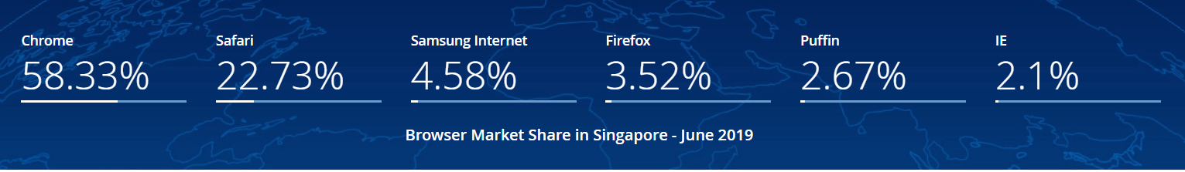
Other Browsers
Default Browser for Apple devices

Slide 8
Safari Extension
Safari Extension Component | Explanation | Google Chrome Extension Parallel
Global HTML Page | HTML page containing Javascript support code (Never Displayed) | background.js
Content Files | HTML, CSS, Javascript content to display | popup.html, popup.js
Injected Scripts | Javascript files injected into browser content | contentscript.js
Injected Style Sheets | Overides/adds to styles applied | style.css
Icon | Scaled up/down for usage | icon.png
* Safari Extension is written in Javascript, CSS and native code written in Objective-C or Swift
https://developer.apple.com/library/archive/documentation/Tools/Conceptual/SafariExtensionGuide/ExtensionsOverview/ExtensionsOverview.html

Slide 9
Chrome Extension Potential Usages
Data Scraping (From webpages/ research papers?)
Serve as link between front-end and ML models

Slide 10

AWS Lambda

Slide 11
What is AWS Lambda
Compute service that lets you run code without provisioning or managing servers
Scales automatically
Pay only for compute time
Notes:
https://www.tutorialspoint.com/aws_lambda/aws_lambda_overview

Slide 12
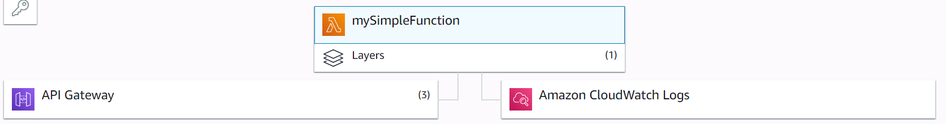
My Design
Lambda function
Main code for model (Naïve Bayes)
API Gateway
Allow API calls to be made to the Lambda function
Amazon CloudWatch Logs
Collects logs from API calls

Slide 13
AWS Lambda Potential Usages
Allow models to be hosted in the cloud, by AWS
Able to work with other AWS services (Sagemaker,AWS Comprehend etc)

